Slide 1

Lesson Eight Concerns
The Harnessed Atom

Slide 2
What concerns do people have about nuclear power plants:
Safety at nuclear power plants
Design features
Engineered safety
Barriers and backups
Regulations
Security
Accidents
Three Mile Island
Chernobyl
Fukashima
Learning from accidents

Slide 3
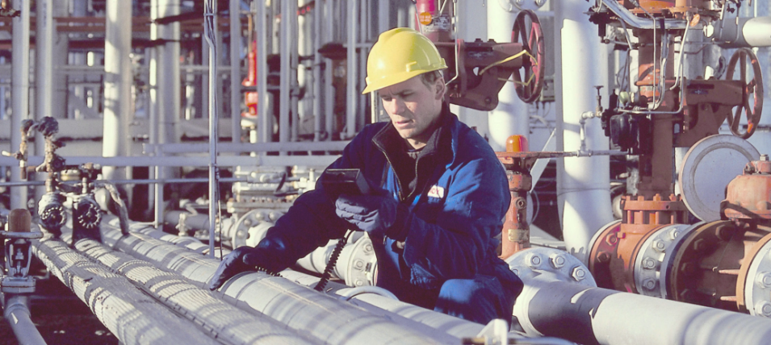
What is the main concern people have about nuclear power plants?
Safety
As a nuclear power plant produces electricity, its fuel becomes very radioactive. High levels of radiation are dangerous. To protect the workers and people living nearby, this radiation must be kept inside the reactor and away from the environment.
Notes:
The primary safety consideration in the operation of any nuclear reactor is the control and containment of radioactive material, under both normal and accident conditions. Numerous controls and barriers are installed in nuclear plants to protect workers and the public from the effects of radiation.
In this photo, a plant operator tests a nuclear power plant’s piping to monitor ionizing radiation.
The Nuclear Regulatory Commission (NRC) places at least two resident inspectors at each nuclear power plant. They provide first-hand, independent assessment of plant conditions and performance.

Slide 4
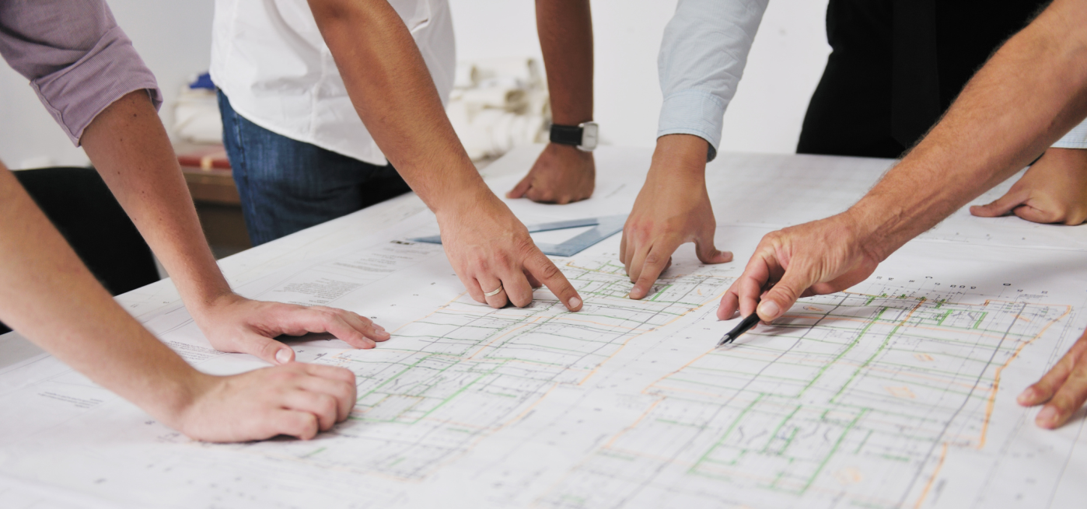
Nuclear power plants are designed with safety in mind.
Scientists, engineers, architects, and regulators all work together when plants are designed.
Nuclear power plants have many controls and barriers to protect workers and the public from radiation.
Notes:
Nuclear power plants are some of the most sophisticated and complex energy systems ever designed. (Source: Jan Willem Storm van Leeuwen (2008). Nuclear power – the energy balance). Ask students what they remember from Lesson 7 about reactor design that makes them safe. (Containment buildings are thick steel-reinforced concrete. Loops are independent and sealed. The control room has all operating data available, etc.)
The emergency power supply for a nuclear power plant is made several times redundant by diesel generators and battery backups. Failure of the cooling systems are also anticipated with back-up systems.

Slide 5
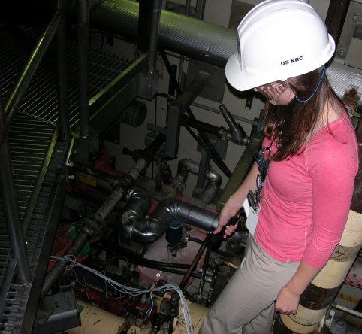
What makes U.S. nuclear power plants safe?
Safety systems are built into nuclear power plants to control the reaction and contain radioactive material.
Safety features in the equipment include
Using laws of physics and natural properties of materials
Using engineered safety systems that have many backups
Using strong barriers that keep radiation inside if systems fail
4. Training workers to manage routine operations and emergency situations.
Notes:
This slide introduces these four safety features coming up.

Slide 6
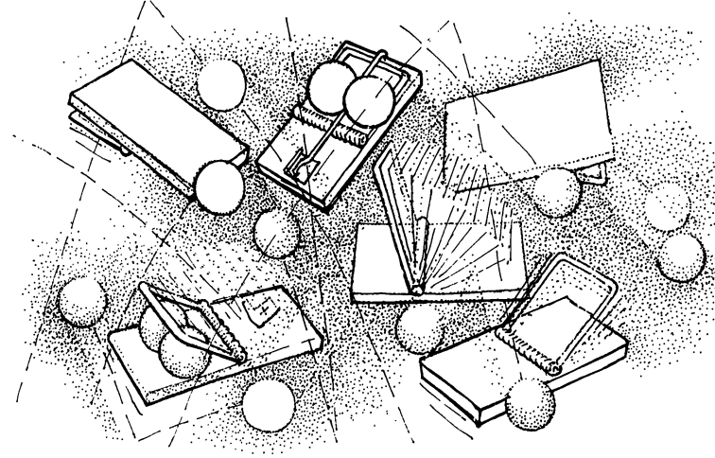
Scientific laws help make nuclear power plant designs safer.
It’s actually difficult to get a chain reaction going and then keep it going.
The fuel, the coolant, and the chain reaction process itself help safeguard against accidents.
Without the coolant (water), neutrons move too fast to be captured by the fuel and the chain reaction cannot continue.
Notes:
Basically, it’s not easy to get a chain reaction going and then to keep it going.
Why can’t a reactor explode? It does not have the capability to produce a burst of energy that one would associate with a bomb. The material in a reactor is distributed in such a way that it does not release energy instantaneously; rather, it is a controlled reaction that sustains energy production in order to produce electricity.

Slide 7
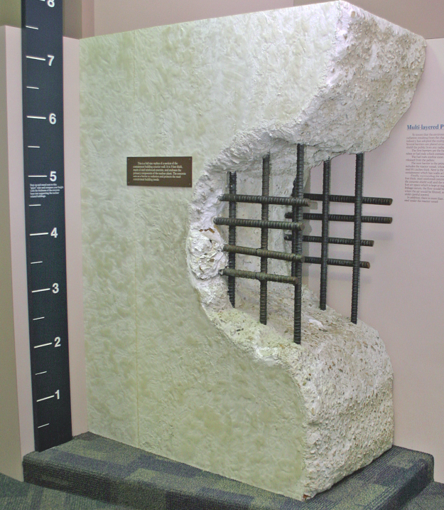
The reactor is surrounded by a massive containment wall.
Steel reinforcement bars
1.2-meter-thick
concrete wall
Notes:
What barriers provide protection from radiation produced by a nuclear power plant?
The radioactive material that fuels a nuclear power plant is contained in ceramic fuel pellets capable of withstanding thousands of degrees of heat. These fuel pellets are encased in hollow metal rods that help keep the material from interacting with the water that cools the reactor. In addition, the reactor's thick metal walls and piping, as well as a massive reinforced concrete containment structure, are designed to keep the coolant, fuel, and associated radiation isolated from the environment.
NRC, http://www.nrc.gov/about-nrc/radiation/related-info/faq.html#25

Slide 8
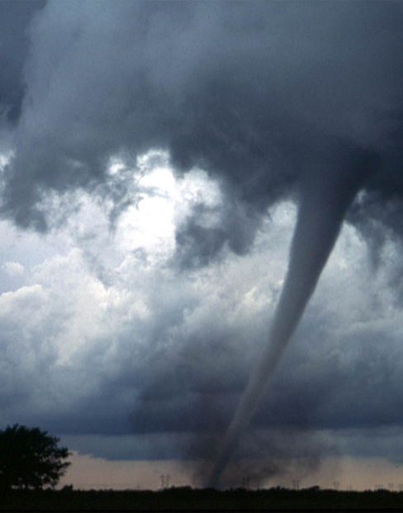
Nuclear power plants are designed to address emergencies.
Scientists, engineers, architects, and regulators design nuclear power plants to
include multiple backup safety systems
be strong enough to survive tornadoes, hurricanes, fires, floods, earthquakes, and tsunamis, or the crash of a plane
Notes:
If nuclear reactors became a target during military conflict, security systems are in place. Plants are fenced, electronically monitored, patrolled by security, and an emergency shutdown in place to prevent release of radioactivity. The containment building and its missile shield are safe against hypothetical airplane attacks.
All U.S. nuclear power plants are required to maintain or restore cooling for the reactor core, containment building, and spent fuel pool under the circumstances associated with a large fire or explosion. These requirements include using existing or readily available equipment and personnel, having strategies for firefighting, operations to minimize fuel damage, and actions to minimize radiological release to the environment.
Photo from NOAA: PD-USGOV-DOC-NOAA; PD-USGOV-NOAA. Source http://www.nssl.noaa.gov/headlines/dszpics.html

Slide 9
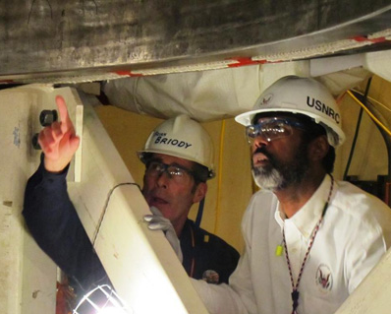
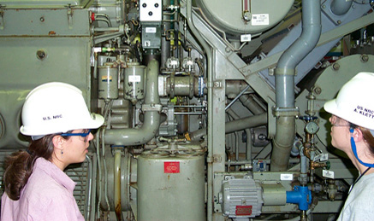
Nuclear power plants are inspected often.
The reactor automatically shuts itself down unless all systems are working correctly. Nuclear power plant safety systems are inspected by workers and regulators.
Notes:
The three primary objectives of nuclear safety systems are to
shut down the reactor Ask Students: Is shutting down the reactor control or containment? (control)
maintain it in a shutdown condition. Ask Students: Is this objective control or containment? (control)
prevent the release of radioactive material during events and accidents. Ask Students: Is this control or containment? (containment)

Slide 10
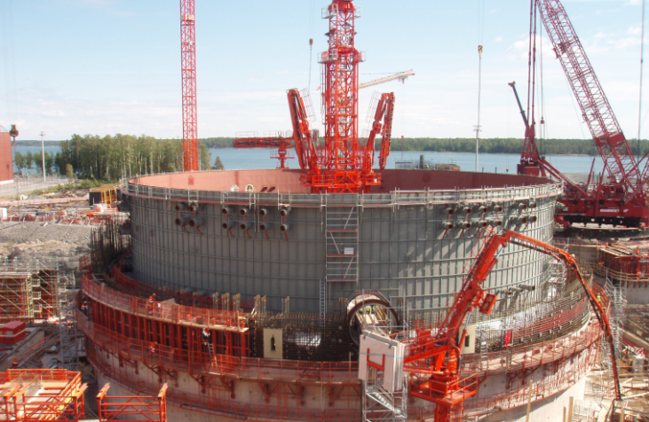
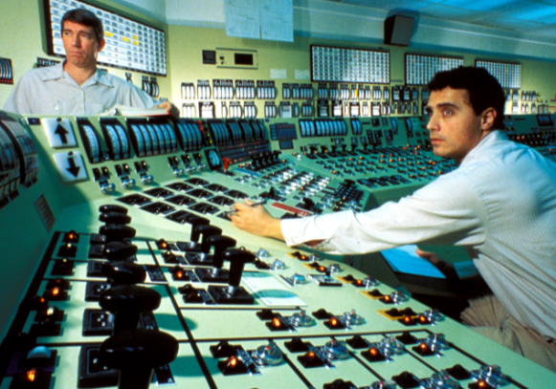
The Nuclear Regulatory Commission enforces safety requirements.
Congress created the Nuclear Regulatory Commission to enforce safety requirements for nuclear power plants. For example, NRC licenses and inspects construction of new plants.
They also set requirements for the control room operators.
Notes:
The Nuclear Regulatory Commission (NRC) employs at least two resident inspectors to work daily at each nuclear power plant. They provide first-hand, independent assessment of plant conditions and performance.
The Atomic Energy Act of 1954 regulated safety with both civilian and the military uses of nuclear materials. The Energy Reorganization Act of 1974 established the NRC as a regulator and the Department of Energy as the developer and producer of nuclear weapons and other energy-related work. The 1974 Act also protects employees who raise nuclear safety concerns.

Slide 11
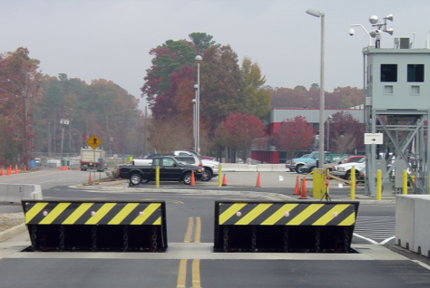
Security is a top priority at nuclear plants.
Every nuclear power plant has
Security patrols
Physical barriers
Strict rules
Emergency plans
Frequent worker training
Notes:
Trained and armed security guards protect power plants. There are security barriers in place too.
Emergency preparedness programs enable emergency personnel at power plants to rapidly identify, evaluate, and react to a wide spectrum of emergencies, including those arising from terrorism or natural events such as hurricanes.
Many of your students may not know about the Oklahoma City bombing or September 11, 2001 terrorist attacks. This may be an opportunity to teach these topics.

Slide 12
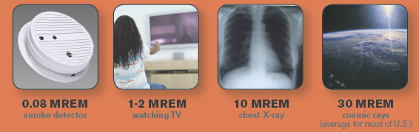
Is living near a nuclear power plant dangerous?
Most scientists agree that the tiny amounts of radioactivity released from nuclear power plants during normal operations are insignificant when compared to normal levels of natural background radiation we receive every day. Plants usually release 0.005 millisieverts (0.5 millirems) per year or less.
Notes:
In late March 2011, scientists at Cook Nuclear Power Plant in Michigan took measurements of the radiation around their site. They recorded a level of .0005 millisieverts (mSv) or 0.05 millirems (mrem). The graphic below shows how this level compares to other naturally occurring and human-made radiation that Americans are exposed to each year.
Ask students to compare the.0005 mS/v0.05 mrem from the nuclear power plant with something they do or have done from the illustration above. [Answer: Dental radiography: 0.005 mSv; Brain CT scan: 0.8–5 mSv (possible for students with concussion)]
Students can do their own radiation dose calculations at http://www.new.ans.org/pi/resources/dosechart/

Slide 13
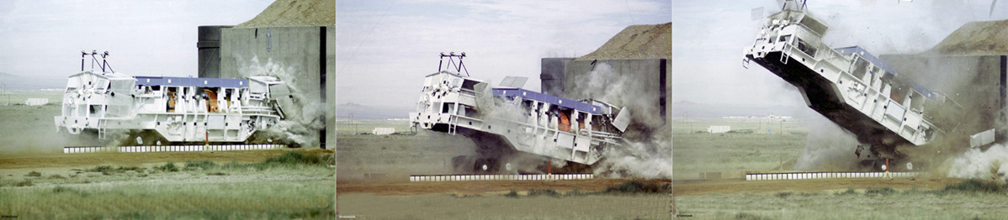
How will spent fuel be transported safely?
Spent fuel casks are designed to protect people and the environment from the radiation from the fuel a cask holds. Casks have been tested to survive the most severe accidents.
Video clip: Containers used to transport used nuclear fuel survive test crashes. http://www.youtube.com/watch?v=U1nvRBk4W3o
Notes:
Since 1965, approximately 3,000 shipments of spent nuclear fuel have been transported safely over U.S. highways, waterways, and railroads.
The clip above runs about 1.5 minutes. Highlight the url with your cursor. Right click from your mouse to select “Open Hyperlink.”

Slide 14
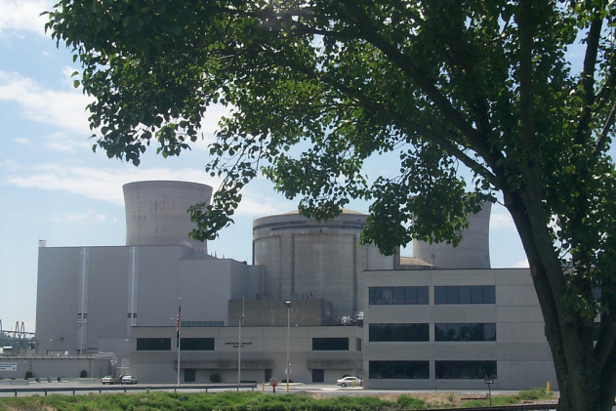
What happened at Three Mile Island?
Mechanical failures and mistakes by workers caused an accident at Three Mile Island in Pennsylvania in 1979 that
Lost coolant from the core and caused serious reactor fuel damage
Released high levels of radiation inside the containment building
Exposed people living nearby to an average of 0.01 milliseivert (1 millirem)
Did not cause any serious injuries or deaths.
Concerned a lot of people.
Notes:
Three Mile Island is on the Susquehanna River, south of Harrisburg, Pennsylvania. It has two separate units, known as TMI-1 and TMI-2. The plant is widely known for having been the site of the most significant accident in United States commercial nuclear energy, when TMI-2 suffered a partial meltdown. A core melt down is an informal term for what occurs when the heat generated by a nuclear reactor exceeds the heat removed by the cooling systems to the point that at least one nuclear fuel element melts the primary containment and radioactive fuel leaches into the coolant.
The U.S. Nuclear Regulatory Commission found that the containment at the site worked. The accident resulted in no deaths or injuries to plant workers or members of nearby communities. The reactor core of TMI-2 has since been removed from the site. TMI is still actively producing electricity.
Photo from NRC http://www.flickr.com/photos/nrcgov/6517605077/sizes/z/in/photostream/

Slide 15
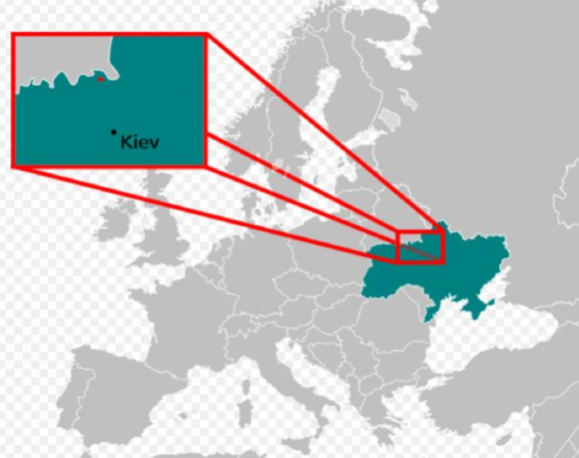
What happened at Chernobyl?
In 1986 workers caused a sudden power surge that ruptured the reactor vessel at the Chernobyl power plant in the Ukraine.
28 workers died.
Contamination spread over the western Soviet Union and Europe.
The reactor was a different design than is used in other countries and did not have a containment building.
Chernobyl Reactor
Notes:
The Chernobyl accident caused many severe radiation effects almost right away. There were about 600 workers at the site when the accident happened. Two workers died soon after the accident. Another 134 workers had acute radiation sickness from the high doses they got, and 28 of those workers died in the first four months after the accident. Up to 600,000 workers helped with clean-up.
The Chernobyl accident spread contamination to areas of Belarus, Russia, and Ukraine where millions of people live. A large number of children and teen-agers got doses to their thyroids from drinking milk that was contaminated by radioactive iodine. So far, about 4,000 of cases of thyroid cancer resulted. Most of the children were treated successfully, but nine died from thyroid cancer.

Slide 16
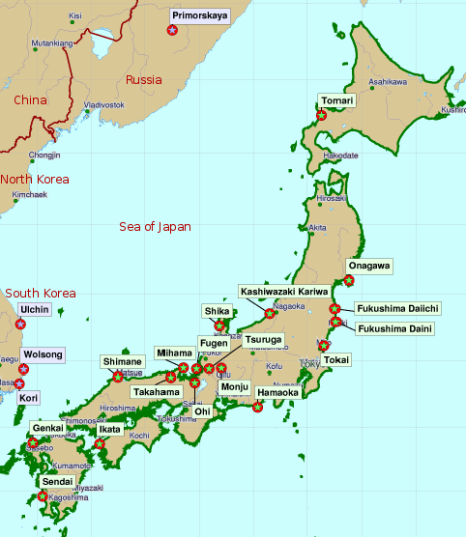
What happened at Fukushima in Japan?
A powerful earthquake in March 2011 caused three operating reactors in Japan to shut down.
The earthquake disrupted electricity, so backup generators powered pumps to circulate cooling water.
A massive tsunami then washed over the backup generators and knocked out emergency power.
One worker drowned in the tsunami. Radiation was released and people living nearby were evacuated. Some food and water was contaminated.
Notes:
The earthquake was a level 9. When the earthquake happened, the working reactors at the plant shut down the way they are supposed to. But soon after a tsunami, the generators were not working and plant operators were not able to cool the fuel in the these operating reactors. Damage to the nuclear fuel resulted in explosions of hydrogen gas and damage to parts of the reactors and the containment structures. People near the plant were evacuated, some food and water supplies have been affected, and workers have been exposed to radiation. At least one worker died, but probably from the tsunami (tidal wave) rather than from radiation sickness.

Slide 17
How do we plan for risks?
Scientists study accidents and make changes to improve safety.
Scientists use a process called risk assessment to identify potential hazards of an activity or technology.
They also study the likelihood that a specific unwanted event will occur.
Then they design systems to reduce risk and also make plans for an unwanted event.
Notes:
For example when new seismic hazard information about an area becomes available, scientists evaluate the new data and models and determine if any changes are needed at nuclear power plants. The NRC examined 2011 earthquake-related information to assess potential safety implications for nuclear power plants in central and eastern states. Analysis of these updates indicated slight increases to earthquake hazard estimates for some plants. New seismic models are being developed by NRC, the U.S. Department of Energy, and the Electric Power Research Institute and will be reviewed by the U.S. Geological Survey. The NRC expects to determine whether any plant improvements are needed in 2012.

Slide 18
Summary: Fill in the blanks
In decisions to design, build, license, and operate nuclear power
plants, safety is the prime concern.
Engineers design a series of barriers to provide layers of containment so radiation is not released during regular operations of a nuclear plant or during an emergency. They design nuclear fuel plants to withstand natural disasters, including fire, floods, tornadoes, earthquakes, tsunamis, and hurricanes.
The characteristics of the fuel, the coolant, and the chain reaction process itself safeguard against accidents.
Every safety-related system in a nuclear plant has backup systems.
Notes:
The answers are in the sentences above. You can turn this page into an activity using your cursor to highlight the blank spaces. Use your toolbar to make the answers’ font not white.
Review these facts with students before or after a quiz.

Slide 19
Summary (continued)
The security of nuclear power plants is also part of safety. In ensuring safety and security, workers at nuclear power plants spend many hours planning, training, and practicing for emergencies.
Nuclear power plants in the United States have been very reliable and have a record for operating safely. However, the record is not perfect. There have been accidents at nuclear power plants. The most serious ones did not happen in the United States.
When there is a problem at a power plant anywhere in the world, experts study what happened to find ways to make plants safer.
Notes:
The answers are in the sentences above. You can turn this page into an activity using your cursor to highlight the blank spaces. Use your toolbar to make the answers’ font not white.
Review these facts with students before or after a quiz.

Slide 20
Summary (continued)
Each way that we have of producing electricity has its own set of safety concerns. For this reason, each type of power plant—coal, nuclear, hydro, natural gas, solar, wind—has special design features to protect people and the environment.
The safety requirements are strictest for nuclear power plants.
Notes:
The answers are in the sentences above. You can turn this page into an activity using your cursor to highlight the blank spaces. Use your toolbar to make the answers’ font not white.
Review these facts with students before or after a quiz.

Slide 21
Lesson 8 Vocabulary
architect – one who designs buildings and advises builders during construction
backup – to support or be available to serve as a substitute; a person or thing that recovers a system in the event of an accident or equipment failure
barrier– an obstacle that prevents movement or access
Chernobyl – the site in Ukraine in the former Soviet Union where the most serious nuclear power plant accident occurred in 1986
dirty bomb – a device designed to spread radioactive material
design feature – an intended or understood part of a plan or thought; one of many characteristics that defines the plan for a structure, form, or device
engineer – a designer or builder who applies principles of science and mathematics to make structures, machines, products, systems, and processes ; to design or build

Slide 22
Vocabulary
exposure – contact with something; may be harmful or beneficial
Fukushima Dai-Ichi – the site in Japan of a nuclear power plant accident that resulted from an earthquake and tsunami in 2011
Nuclear Regulatory Commission (NRC) – an independent federal agency that ensures the safe use of radioactive materials for beneficial civilian purposes while protecting people and the environment
permanent disposal – a deep geologic repository for spent fuel and high-level nuclear waste
regulation – a rule or directive made and maintained by an authority; the status of being required to follow rules made and maintained by an authority
regulator – a person who supervises a particular industry or business activity

Slide 23
Vocabulary
regulatory agency – a public authority or government agency responsible for supervising or exercising authority over some area of human activity
safeguard – a way to prevent a problem or accident; to protect against something undesirable
safety system – a design that works automatically to prevent accidents; a system that reduces possible hazards due to human error
security - the safety of an organization against criminal activity such as terrorism, theft, or spying
Three Mile Island – the site in Pennsylvania of a 1979 nuclear power plant accident
tsunami – an unusually large sea wave produced by an undersea earthquake

Slide 24

Advanced Student Assignment: Nuclear power plants safety involves both control and containment.
The most important operation at any nuclear reactor is the control and containment of radioactive materials, under both normal and accident conditions.
What is control?
Is control different from containment?
Does this photo illustrate control or containment?
Notes:
Ask students: What is control? Define the word. (Answer: Control is determining the behavior of a course of events. In the case of a nuclear power plant, control is determining the use of energy from ionizing radiation.)
Ask students: How is control different from containment at a nuclear power plant? (Answer: Control is using energy to do what you want it to do. Containment is controlling something beyond its use. Compare the two terms with taking care of a dog: You control a dog with commands that you teach him, like “sit” and “stay.” You control him with a lease when you walk him. But you also contain your dog. You keep him inside your house, maybe inside a crate. Outside, you may use a fenced yard. That step is containment. With containment, you don’t let him get out of control. )
Ask students: Of the design features of a nuclear power plant, Where are the radioactive materials? (Answer: Inside the pressure vessel.) What illustrates control? (Answer: control rods, control room, coolant) What illustrates containment? (Answer: containment building, different loops of PWR, pressure vessel) Remind them of the time, shielding and distance laws also. (For review, go to Lesson 4.)

Slide 25

Advanced Student Assignment: Assessing Risk
Before making the decision to do some things, you have to think through the risks.
Do your own risk assessment.
Write down a goal and how you will do it.
Example: I want to learn to skydive. I will take lessons.
Identify any hazards you will meet.
Record the way you might be exposed to these hazards.
Decide what protective or control measures you can take to be safe.
Check with an adult. Show them your risk assessment for discussion purposes.
Notes:
In the United States, the minimum age for skydiving is 16 according to the United States Parachute Association.
Encourage students to think of other activities for their risk assessment assignment. One activity that you could do with your class is to propose riding a bicycle to school. Go through the steps above. Examples for number 3 include, wearing a helmet, planning a route that has the fewest hazards, and riding with a friend.

